Slide 1
CS162 Operating Systems and Systems Programming Lecture 1 What is an Operating System?
August 29th, 2024
Prof. Ion Stoica
http://cs162.eecs.Berkeley.edu

Slide 2
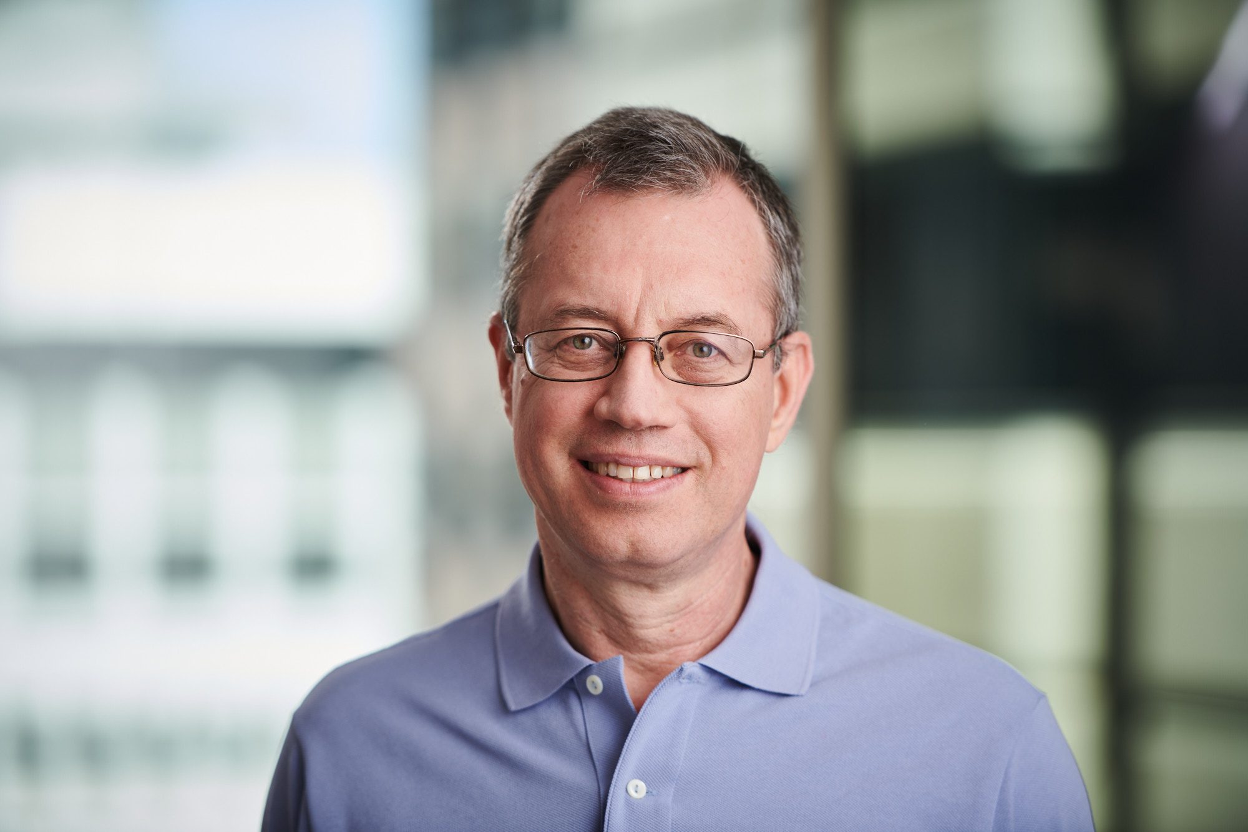



Instructor: Ion Stoica
Web: http://www.cs.berkeley.edu/~istoica/
465 Soda Hall (Sky Computing Lab)
Office hour: Tuesdays, 11-12pm
Research areas:
ML/LLM systems (vLLM, Ray, ChatBot Arena, Alpa, …)
Cloud computing (SkyPilot. SkyStorage)
Previous: Cluster computing (Apache Mesos, Apache Spark, Alluxio), Peer-to-Peer networking (Chord), Networking QoS
Industry experience: co-founded
Conviva (2006 - ): Video distribution and analytics
Databricks (2013 - ): Company behind Apache Spark
Ray (2019 - ): Company behind Ray
Notes:
Mesos – Apple, Netflix, Twitter, Yelp, Airbnb, Groupon, Ebay, PayPal
Spark – Amazon, Baidu, Ebay, Groupon,Yahoo!

Slide 3
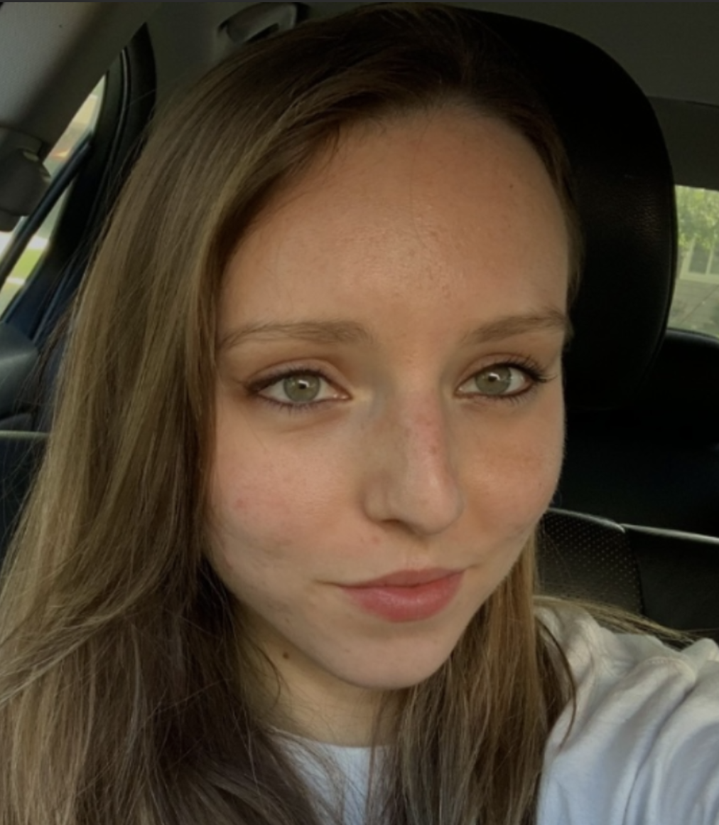







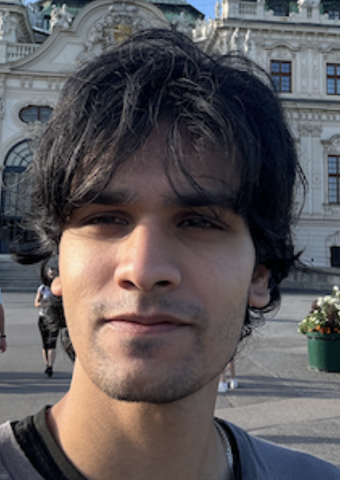
CS162 TAs: Sections TBA
Diana Poplacenel (Head TA)
Jacob Laurence High (Head TA)
Sean Yang
Ryan Almeddine
Sriram Srivatsan
Tushar Goyal
Ethan Zhang
Aarin Kalpeshkumar Salot
Ashwin Chugh

Slide 4


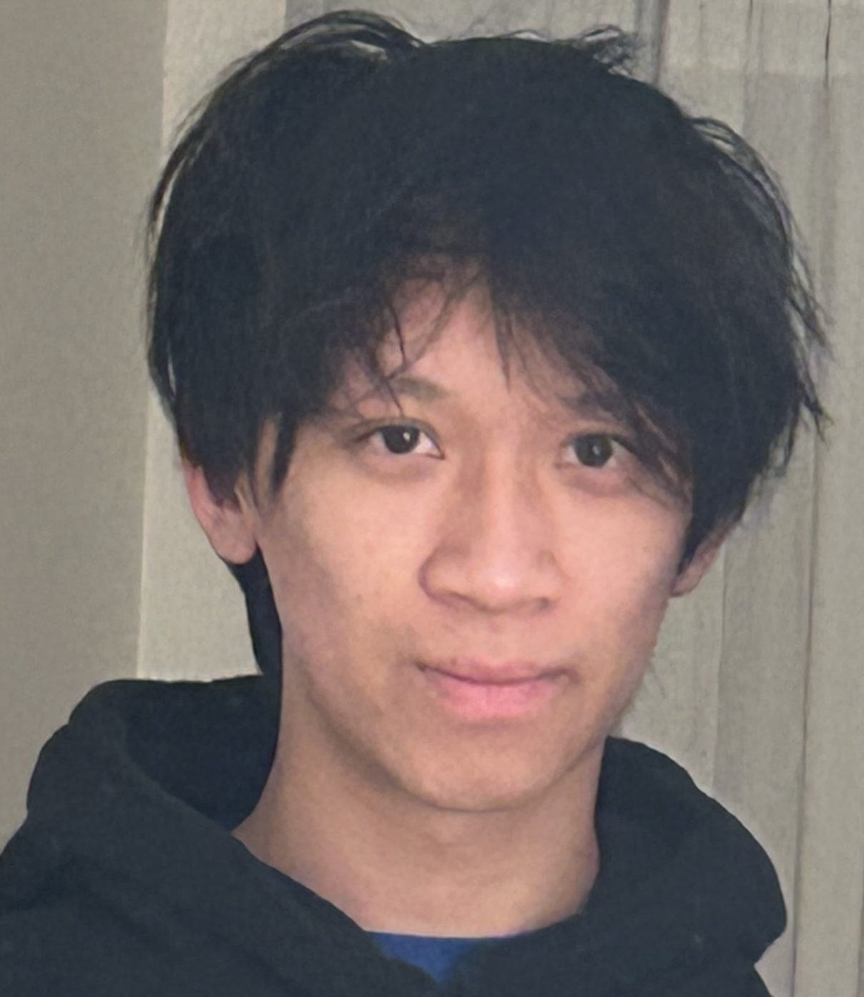
CS162 Readers
Aditya Balasubramanian
Rohan Penmatcha
Jason Guo

Slide 5
Enrollment
This is an Early Drop Deadline course (September 6th)
If you are not serious about taking, please drop early
Department will continue to admit students as other students drop
Really hard to drop afterwards!
Don’t forget to keep up with work if you are still on the waitlist!
On the waitlist/Concurrent enrollment ?
All decisions concerning appeals for enrolling in the course are made by CS departmental staff; the course staff have no say in the matter. Se please do not e-mail us about waitlist or concurrent enrollment.
If people drop, others will be moved off the waitlist

Slide 6
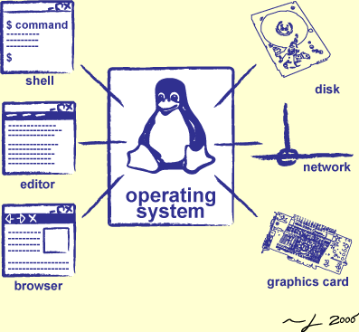
Goals for Today
What is an Operating System?
And – what is it not?
What makes Operating Systems so exciting?
“How does this class operate?”
Interactive is important!
Ask Questions!
Slides courtesy of David Culler, Natacha Crooks, Anthony D. Joseph, John Kubiatowicz, AJ Shankar, Alex Aiken, Eric Brewer, Ras Bodik, Doug Tygar, and David Wagner.

Slide 7
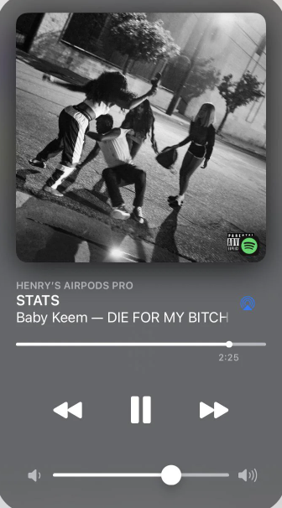
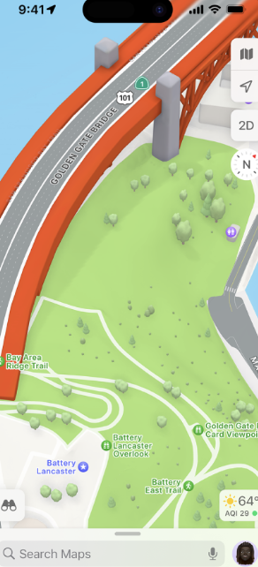
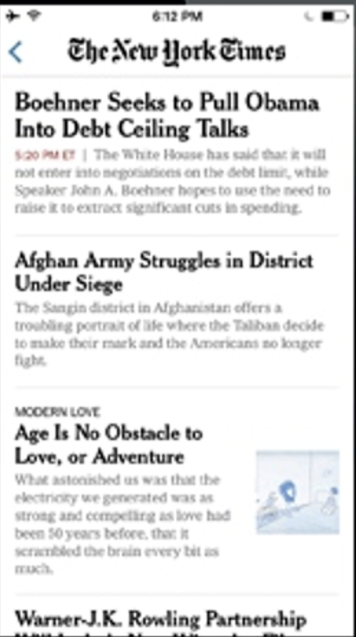
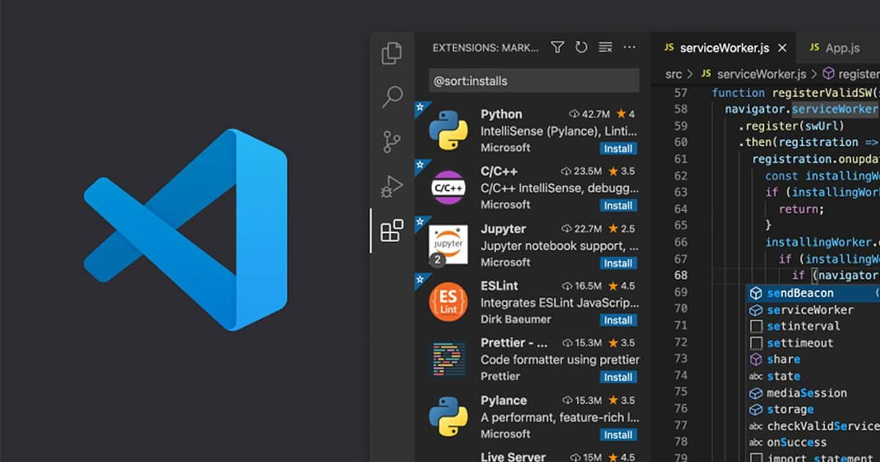
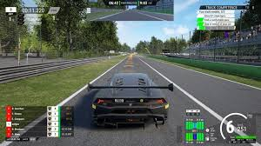
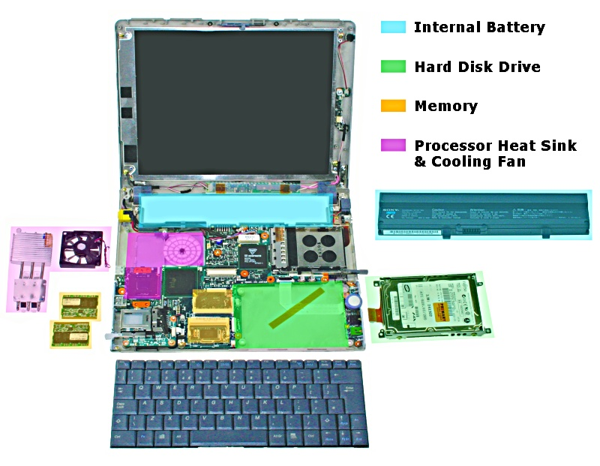
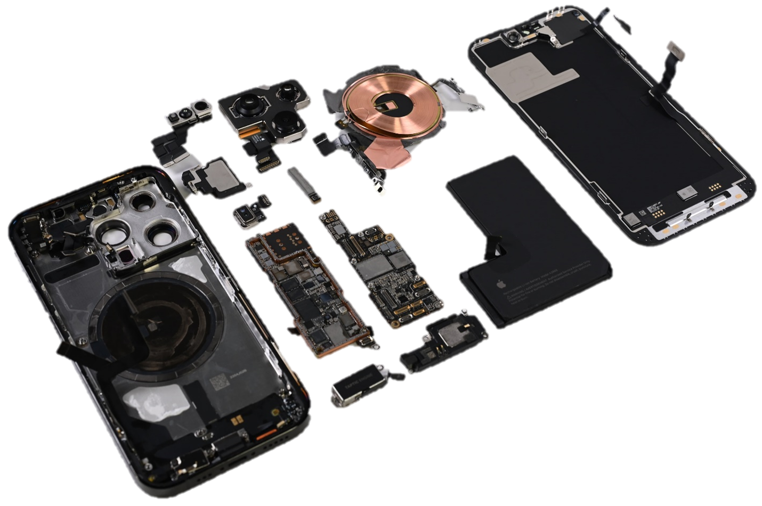
What is an operating system?
Apps
OS (e.g., MacOS, Linux, Windows)
OS (e.g., iOS, Android)
Hardware

Slide 8
What is an operating system?
Special layer of software that provides application software access to hardware resources
Convenient abstraction of complex hardware devices
Protected access to shared resources
Security and authentication
Communication amongst logical entities
appl n
appln
appln
OS
Hardware

Slide 9
What Does an OS do?
Provide abstractions to apps
File systems
Processes, threads
VM, containers
Naming system
…
Manage resources:
Memory, CPU, storage, …
Achieves the above by implementing specific algos and techniques:
Scheduling
Concurrency
Transactions
Security
…..

Slide 10

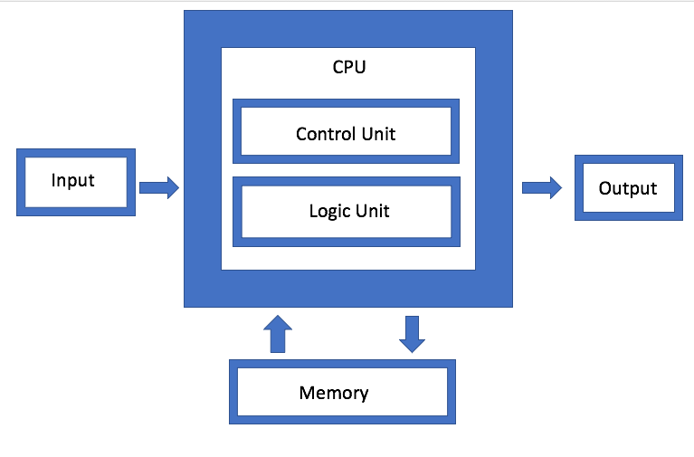
Von Neumann Architecture
John von Neumann
(1903 – 1957)

Slide 11
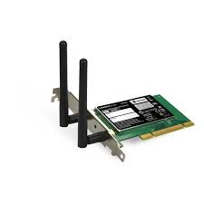
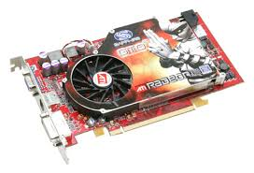
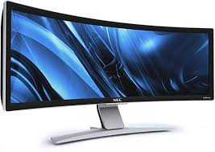

Hardware/Software Interface
Running Program
Software
What you learned in CS 61C – Machine Structures (and C)
Instruction Set Architecture (ISA)
Hardware
Memory
Page Table
& TLB
Processor
Cache
OS Memory
Networks
The OS abstracts these hardware details from the application
Ctrlr
Storage
Displays
Inputs

Slide 12

What is an Operating System?
Illusionist
Provide clean, easy-to-use abstractions of physical resources
Infinite memory, dedicated machine
Higher level objects: files, users, messages
Masking limitations, virtualization

Slide 13
OS Basics: Virtualizing the Machine
Compiled
Program
System Libs
Process: Execution environment with restricted rights provided by OS
Threads
Address Spaces
Files
Sockets
Operating System
ISA
Processor
PgTbl
& TLB
Storage
Networks
Memory
Hardware
OS Mem
I/O Ctrlr

Slide 14
Compiled Program’s View of the World
Compiled
Program
System Libs
Process: Execution environment with restricted rights provided by OS
Threads
Address Spaces
Files
Sockets
Operating System
ISA
Application’s “machine” is the process abstraction provided by the OS
Each running program runs in its own process
Processes provide nicer interfaces than raw hardware
Processor
PgTbl
& TLB
Storage
Networks
Memory
Hardware
OS Mem
I/O Ctrlr

Slide 15
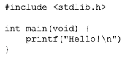
System Programmer’s View of the World
Program
System Libs
Linker
Compiler
Process: Execution environment with restricted rights provided by OS
Threads
Address Spaces
Files
Sockets
Operating System
ISA
Application’s “machine” is the process abstraction provided by the OS
Each running program runs in its own process
Processes provide nicer interfaces than raw hardware
Processor
PgTbl
& TLB
Storage
Networks
Memory
Hardware
OS Mem
I/O Ctrlr

Slide 16
What’s in a Process?
A process consists of:
Address Space
One or more threads of control executing in that address space
Additional system state associated with it
Open files
Open sockets (network connections)
…

Slide 17
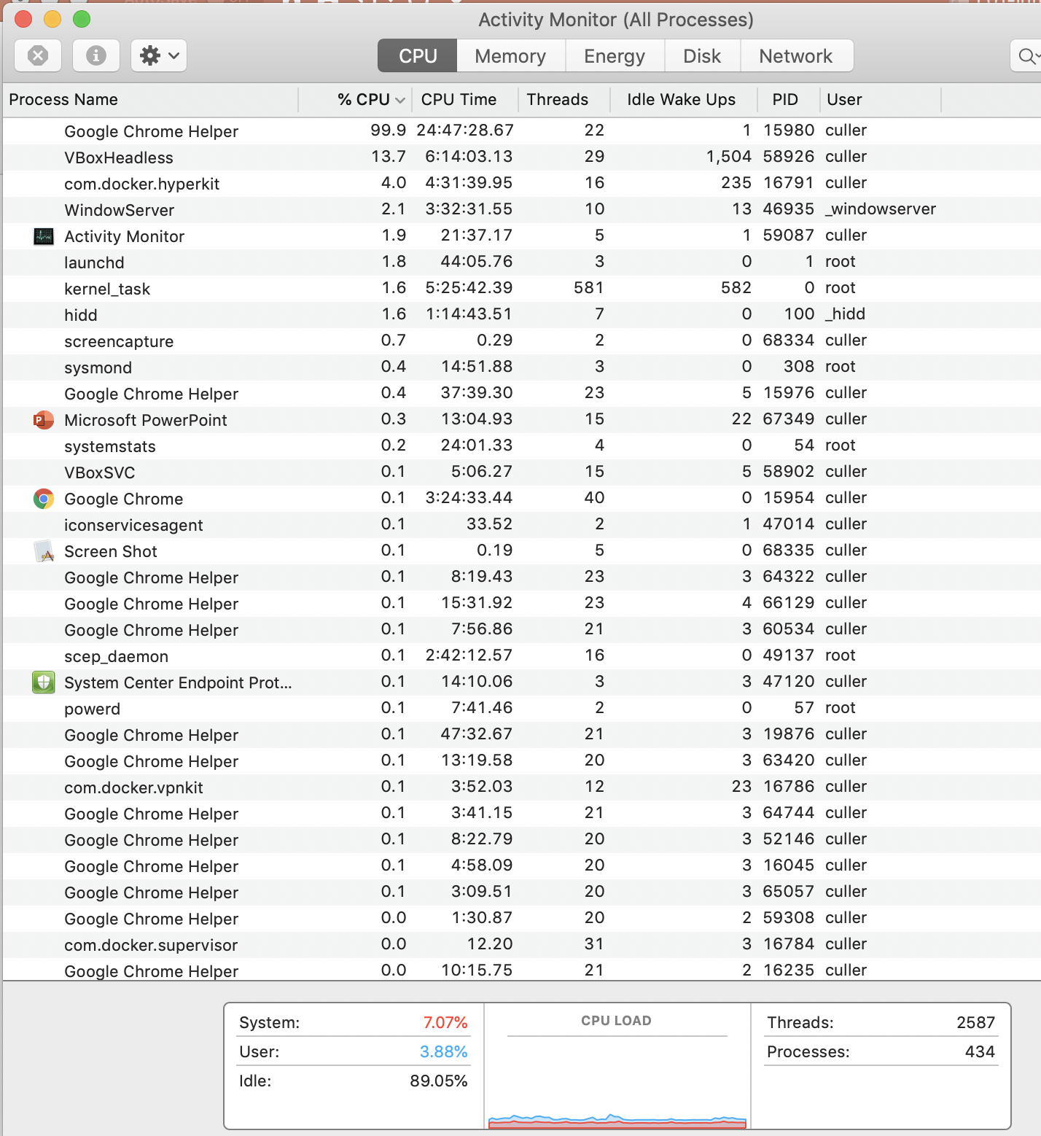
For Example…

Slide 18
Operating System’s View of the World
Compiled
Program 1
Compiled
Program 2
System Libs
System Libs
Compiler
Process 1
Process 2
Threads
Address Spaces
Files
Sockets
Threads
Address Spaces
Files
Sockets
Operating System
ISA
Processor
PgTbl
& TLB
Storage
Networks
Memory
Hardware
OS Mem
I/O Ctrlr

Slide 19
Operating System’s View of the World
Running
Program 1
Running
Program 2
OS translates from hardware interface to application interface
OS provides each running program with its own process
System Libs
System Libs
Compiler
Process 1
Process 2
Threads
Address Spaces
Files
Sockets
Threads
Address Spaces
Files
Sockets
Operating System
ISA
Processor
PgTbl
& TLB
Storage
Networks
Memory
Hardware
OS Mem
I/O Ctrlr

Slide 20

What is an Operating System?
Referee
Manage protection, isolation, and sharing of resources
Resource allocation and communication
Illusionist
Provide clean, easy-to-use abstractions of physical resources
Infinite memory, dedicated machine
Higher level objects: files, users, messages
Masking limitations, virtualization

Slide 21
OS Basics: Running a Process
Compiled
Program 1
Compiled
Program 2
System Libs
System Libs
Compiler
Process 1
Process 2
Threads
Address Spaces
Files
Sockets
Threads
Address Spaces
Files
Sockets
Operating System
ISA
Processor
PgTbl
& TLB
Storage
Networks
Memory
Hardware
I/O Ctrlr

Slide 22
OS Basics: Switching Processes
Compiled
Program 1
Compiled
Program 2
System Libs
System Libs
Compiler
Process 1
Process 2
Threads
Address Spaces
Files
Sockets
Threads
Address Spaces
Files
Sockets
Operating System
ISA
Processor
PgTbl
& TLB
Storage
Networks
Memory
Hardware
OS
Mem
I/O Ctrlr

Slide 23
OS Basics: Switching Processes
Compiled
Program 1
Compiled
Program 2
System Libs
System Libs
Compiler
Process 1
Process 2
Threads
Address Spaces
Files
Sockets
Threads
Address Spaces
Files
Sockets
Operating System
ISA
Processor
PgTbl
& TLB
Storage
Networks
Memory
Hardware
OS
Mem
I/O Ctrlr

Slide 24
OS Basics: Switching Processes
Compiled
Program 1
Compiled
Program 2
System Libs
System Libs
Compiler
Process 1
Process 2
Threads
Address Spaces
Files
Sockets
Threads
Address Spaces
Files
Sockets
Operating System
ISA
Processor
PgTbl
& TLB
Storage
Networks
Memory
Hardware
OS
Mem
I/O Ctrlr

Slide 25
OS Basics: Switching Processes
Compiled
Program 1
Compiled
Program 2
System Libs
System Libs
Compiler
Process 1
Process 2
Threads
Address Spaces
Files
Sockets
Threads
Address Spaces
Files
Sockets
Operating System
ISA
Processor
PgTbl
& TLB
Storage
Networks
Memory
Hardware
OS
Mem
I/O Ctrlr

Slide 26
OS Basics: Protection
Compiled
Program 1
Compiled
Program 2
System Libs
System Libs
Compiler
Process 1
Process 2
Threads
Address Spaces
Files
Sockets
Threads
Address Spaces
Files
Sockets
Operating System
ISA
Processor
PgTbl
& TLB
Storage
Networks
Memory
Hardware
OS
Mem
I/O Ctrlr

Slide 27
OS Basics: Protection
Segmentation fault (core dumped)
Compiled
Program 1
Compiled
Program 2
System Libs
System Libs
Compiler
Process 1
Process 2
Threads
Address Spaces
Files
Sockets
Threads
Address Spaces
Files
Sockets
Operating System
ISA
Processor
PgTbl
& TLB
Storage
Networks
Memory
Hardware
OS
Mem
I/O Ctrlr

Slide 28
OS Basics: Protection
Process 1
Process 2
Process 3
OS isolates processes from each other
OS isolates itself from other processes
… even though they are actually running on the same hardware!
Software
OS Hardware Virtualization
Hardware
ISA
Memory
Processor
Protection Boundary
OS Memory
Ctrlr
Networks
Displays
Storage
Inputs

Slide 29

What is an Operating System?
Referee
Manage protection, isolation, and sharing of resources
Resource allocation and communication
Illusionist
Provide clean, easy-to-use abstractions of physical resources
Infinite memory, dedicated machine
Higher level objects: files, users, messages
Masking limitations, virtualization
Glue
Common services
Storage, Window system, Networking
Sharing, Authorization
Look and feel

Slide 30
OS Basics: I/O
Process 1
Process 2
Process 3
Software
OS Hardware Virtualization
Hardware
ISA
Memory
OS provides common services in the form of I/O
Processor
Protection Boundary
OS Memory
Ctrlr
Networks
Displays
Storage
Inputs

Slide 31
OS Basics: Look and Feel
Compiled
Program
System Libs
Compiler
Process: Execution environment with restricted rights provided by OS
Threads
Address Spaces
Files
Sockets
Windows
Operating System
ISA
Processor
PgTbl
& TLB
Storage
Networks
Displays
Memory
Hardware
OS Mem
I/O Ctrlr

Slide 32
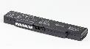
OS Basics: Background Management
Compiled
Program
System Libs
Compiler
Process: Execution environment with restricted rights provided by OS
Threads
Address Spaces
Files
Sockets
Windows
Operating System
Network Manager
Power Manager
ISA
Processor
PgTbl
& TLB
Storage
Networks
Displays
Battery
Memory
Hardware
OS Mem
I/O Ctrlr

Slide 33
What is an Operating System?
Referee
Manage protection, isolation, and sharing of resources
Resource allocation and communication
Illusionist
Provide clean, easy-to-use abstractions of physical resources
Infinite memory, dedicated machine
Higher level objects: files, users, messages
Masking limitations, virtualization
Glue
Common services
Storage, Window system, Networking
Sharing, Authorization
Look and feel

Slide 34
Why take CS162?
Some of you will actually design and build operating systems or components of them
Many of you will create systems that utilize the core concepts in operating systems.
Whether you build software or hardware
The concepts and design patterns appear at many levels
All of you will build applications, etc. that utilize operating systems
The better you understand their design and implementation, the better use you’ll make of them.

Slide 35
What makes Operating Systems Exciting and Challenging?

Slide 36
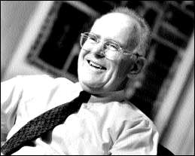
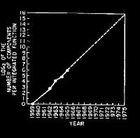
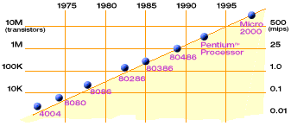
Technology Trends: Moore’s Law
Moore’s Law
2X transistors/Chip Every 2 years
Called “Moore’s Law”
Gordon Moore (co-founder of Intel) predicted in 1965 that the transistor density of semiconductor chips would double roughly every 2 years
Microprocessors have become smaller, denser, and more powerful
Corollary: Performance double roughly every 1.5 years (18 months)
Faster growth because transistors are closer to each other so electrical signals travel faster

Slide 37
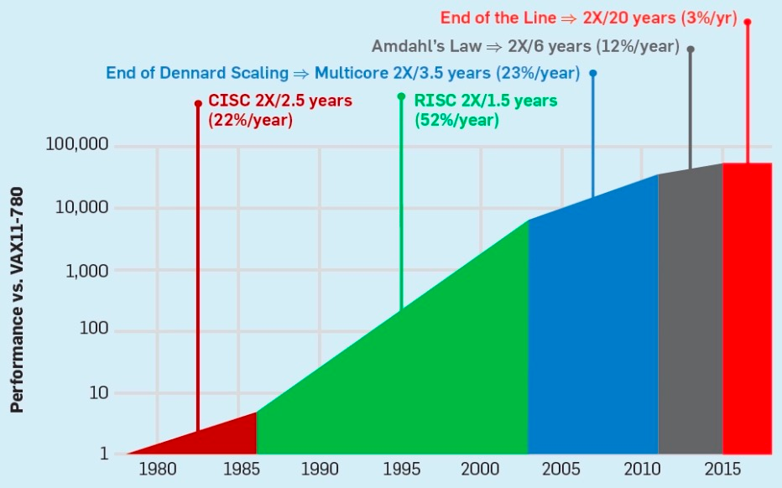
Moore’s Law coming to an end
~1.05x increase every 18 months
~2x increase every 18 months
Notes:
In contrast, according to the well known Moore’s law which powered the computer industry until the beginning of this century, the performance of a single core only doubled every 18 months [C]. Worse yet, since then, the performance growth started to slow down. [C] Today, per core performance, improves just a few percents every 18 months.

Slide 38
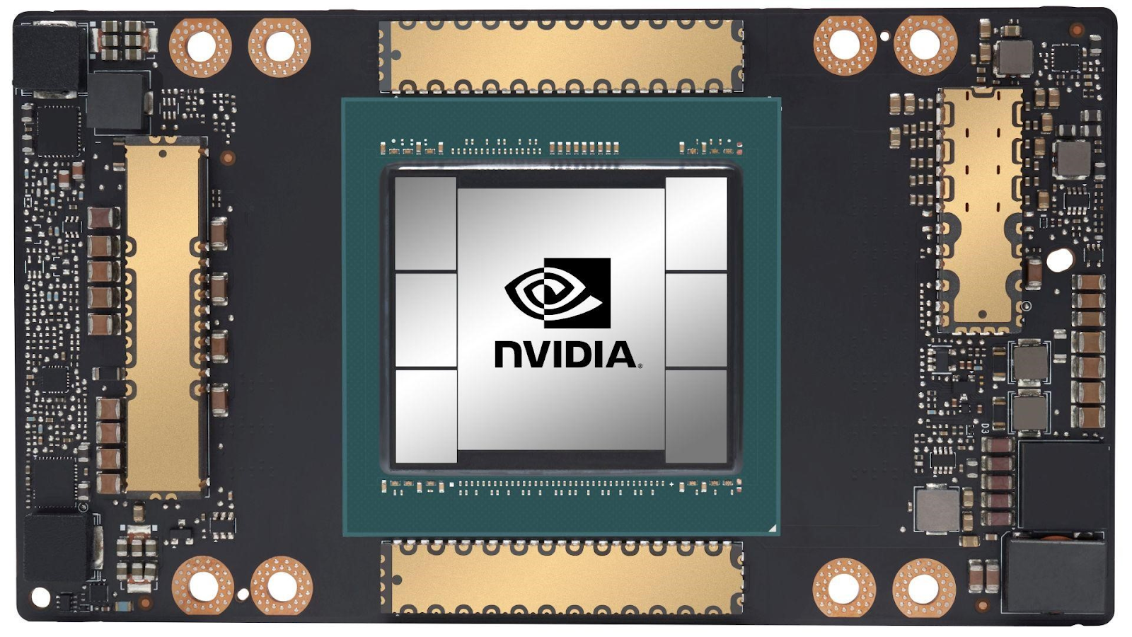
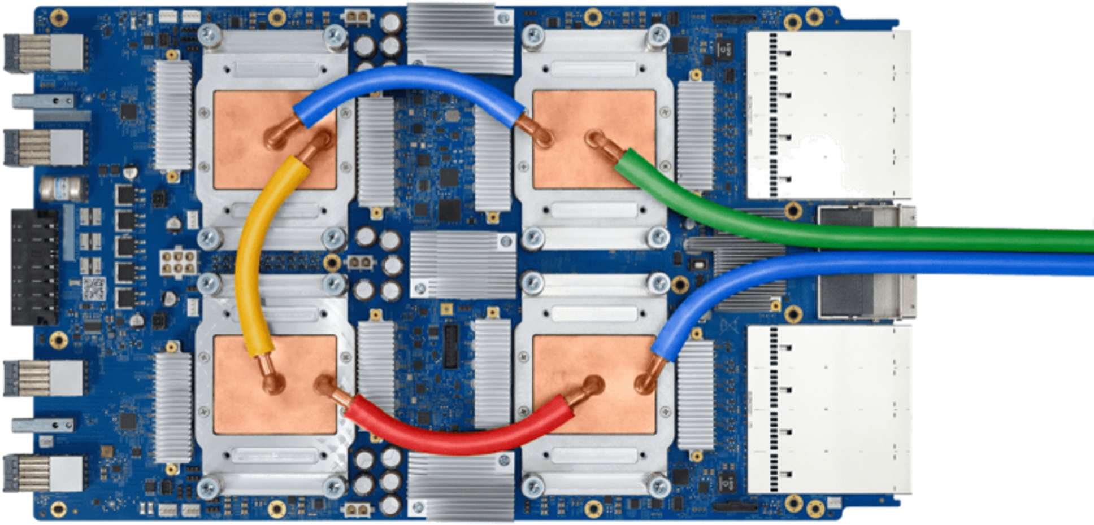
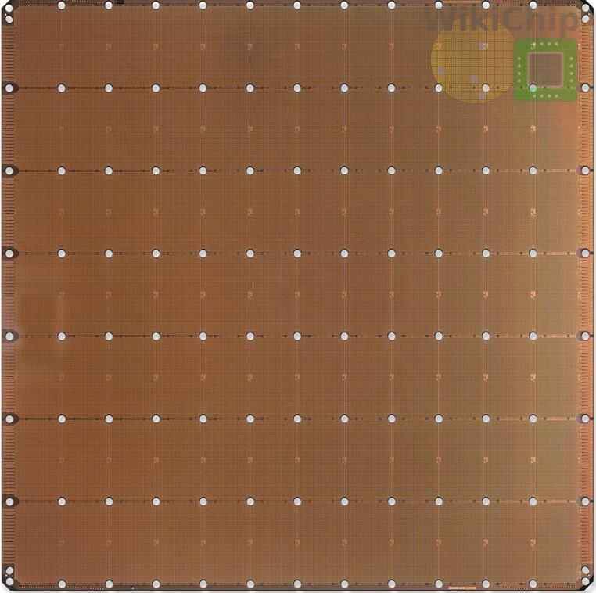
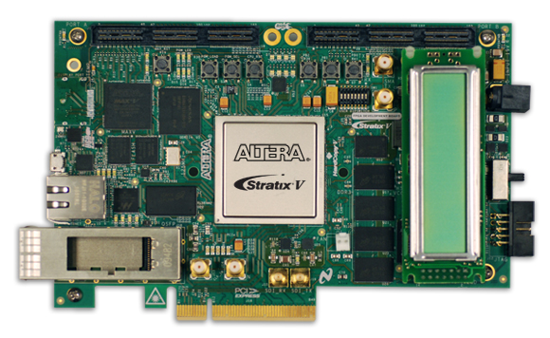
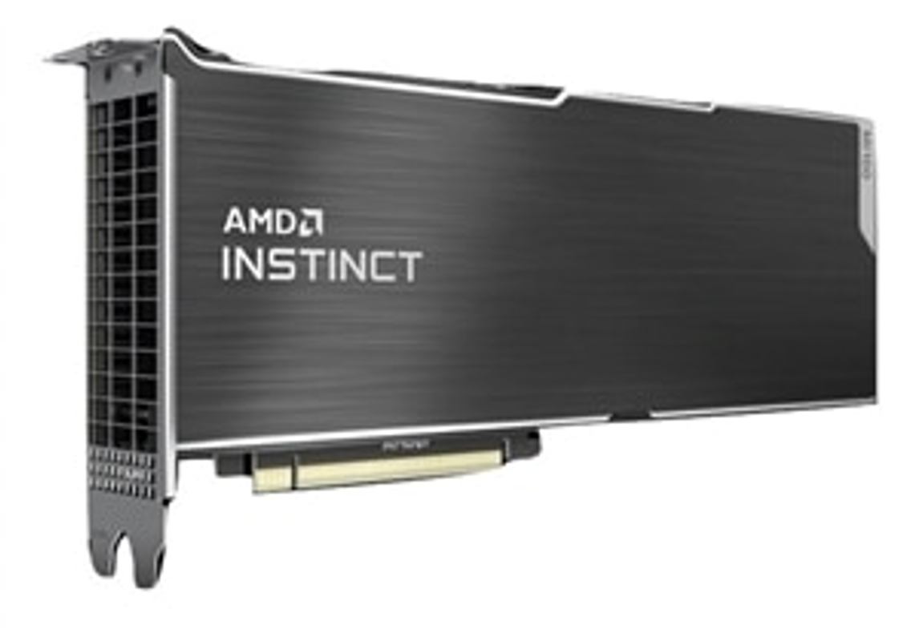
Specialized processors to the rescue
Notes:
But, what about specialized hardware you might ask? After all, over the past decade a plethora of new hardware accelerators have been released to better support AI workloads.

Slide 39
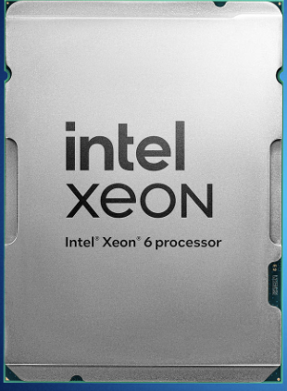
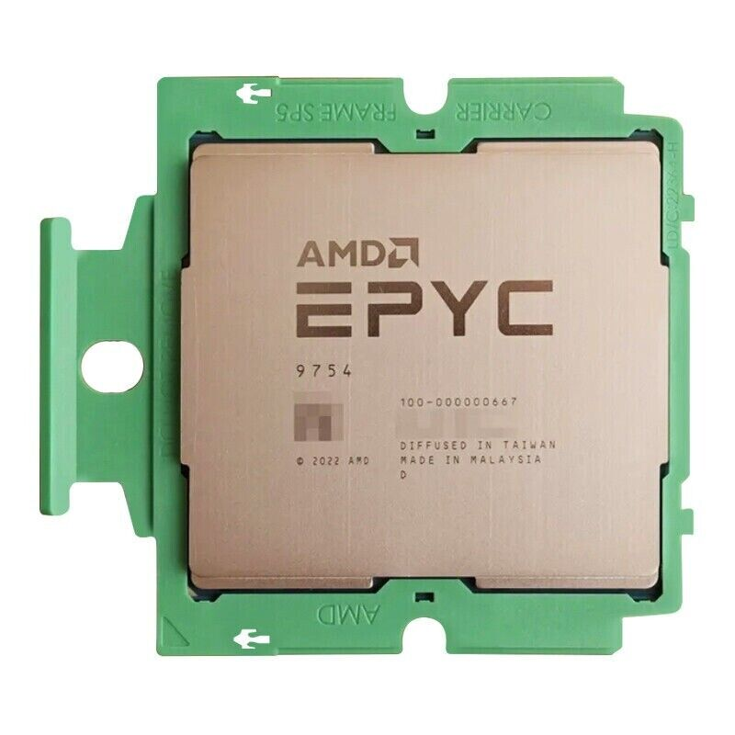
Not only specialized processors…
Multi-core processors
Intel Xeon Sierra Forest: 144 cores; planned 288
AMD Epyc 128 cores; planned 192

Slide 40
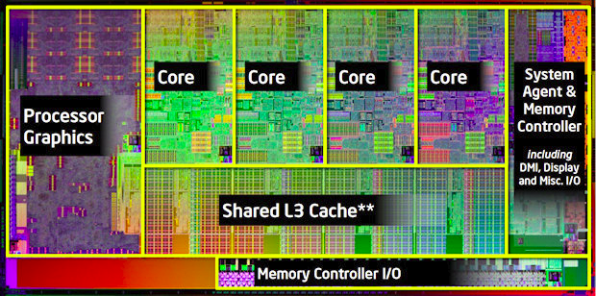
A Modern Processor: Intel Sandy Bridge
Package: LGA 1155
1155 pins
95W design envelope
Cache:
L1: 32K Inst, 32K Data (3 clock access)
L2: 256K (8 clock access)
Shared L3: 3MB – 20MB
Transistor count:
504 Million (2 cores, 3MB L3)
2.27 Billion (8 cores, 20MB L3)
Note that ring bus is on high metal layers – above the Shared L3 Cache

Slide 41
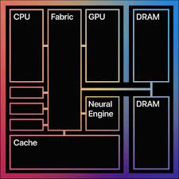
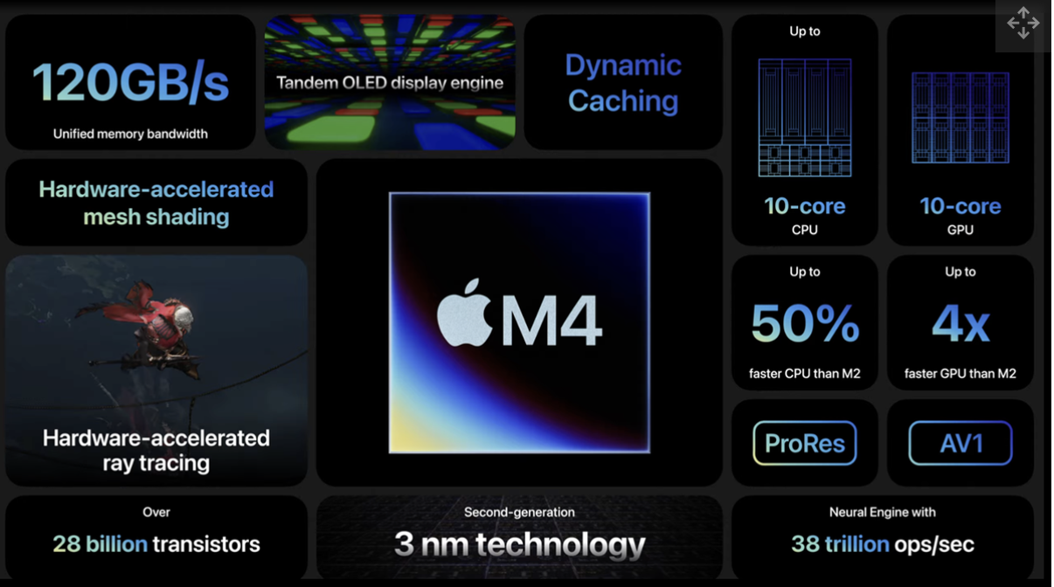
Not only specialized processors…
Multi-core processors
Intel Xeon Sierra Forest: 144 cores; planned 288
AMD Epyc 128 cores; planned 192
System On a Chip (SOC): accelerating trend

Slide 42
SSD overtaking HDD

Slide 43
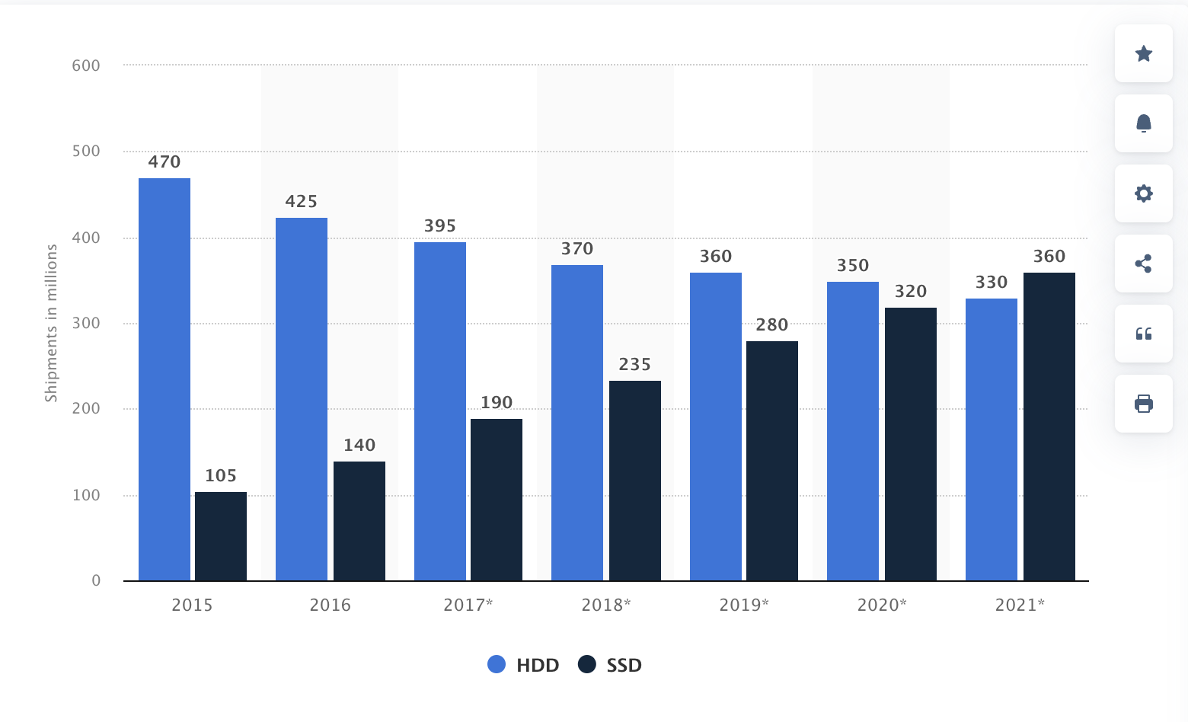
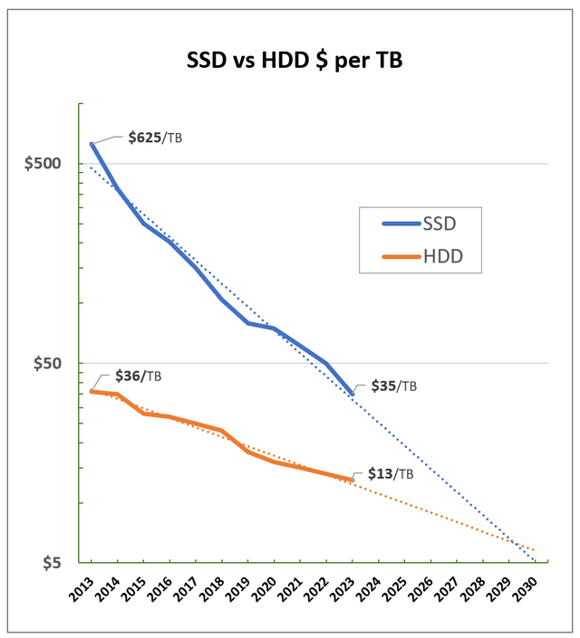
SSD/Flash Dominating
Notes:
Despite being hurt by Moore’s law as well, the SSD capacity will continue to increase significantly (much faster than CPU computation power) due to the more effective use of 3D layering. So expect more storage capacity per core.

Slide 44
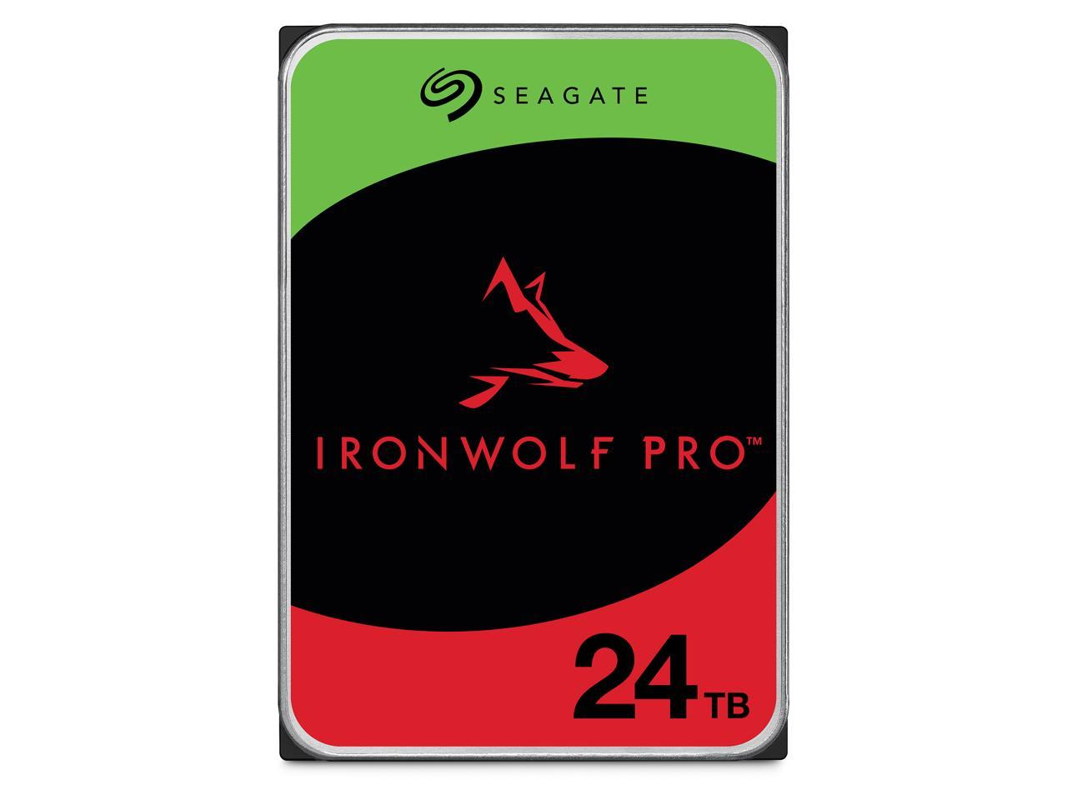
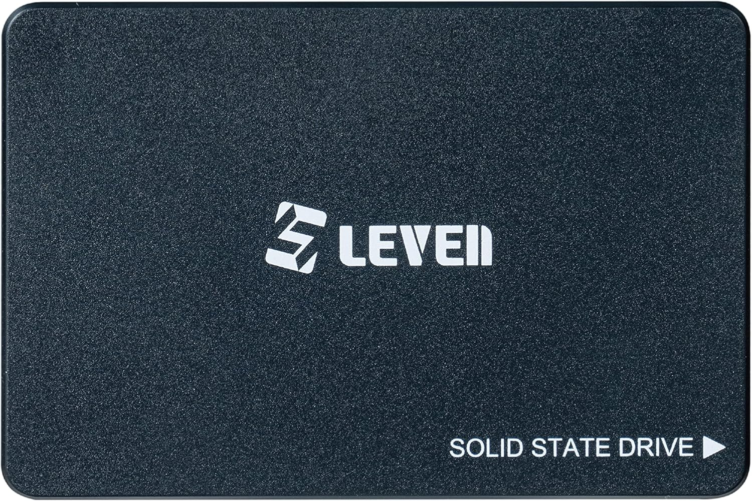
Storage Capacity
Largest SSD 3.5-inch drive:
100 TB @ $40K ($400/TB)
Largest HDD 3.5-inch drive:
24 TB @ $480 ($20/TB)
Cheaper, but
Slower (10x-100x)
Consumes more power
Less reliable
Leven SSD 2.5-inch drive:
4 TB @ $180 ($45/TB)
Notes:
Despite being hurt by Moore’s law as well, the SSD capacity will continue to increase significantly (much faster than CPU computation power) due to the more effective use of 3D layering. So expect more storage capacity per core.

Slide 45
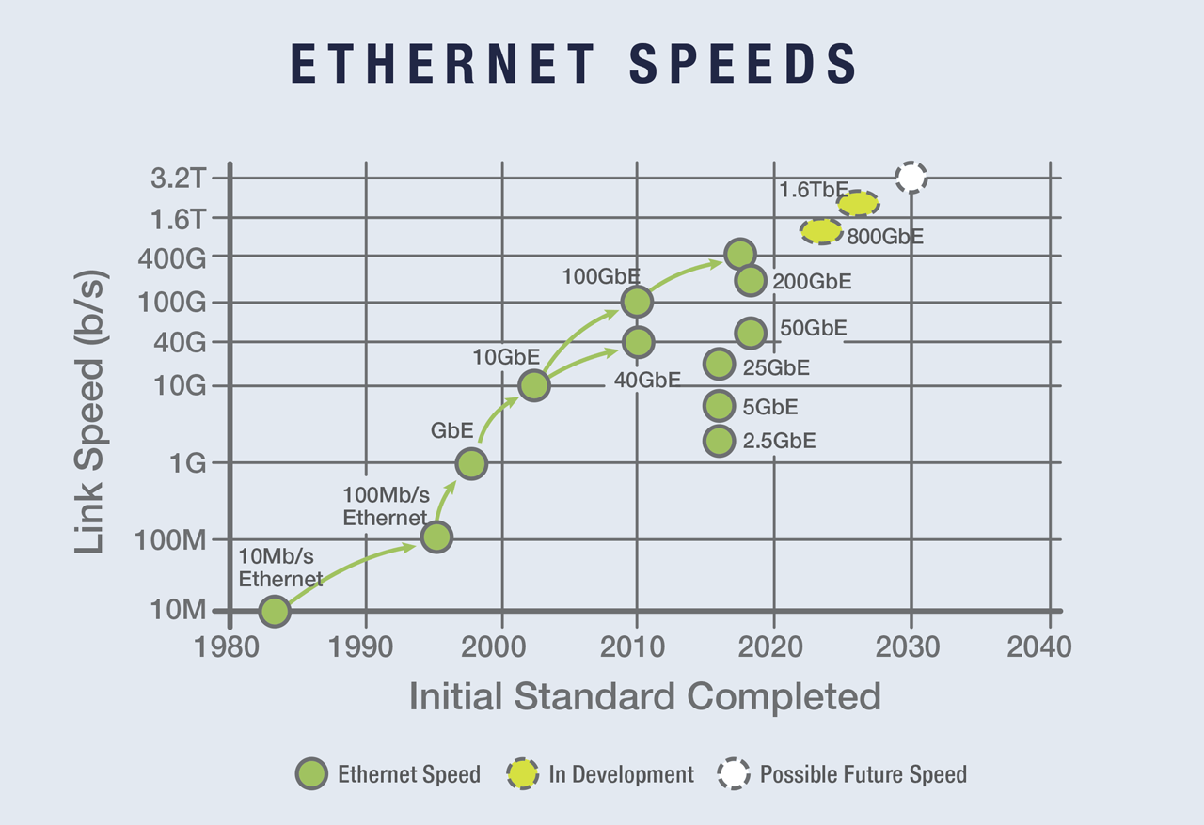
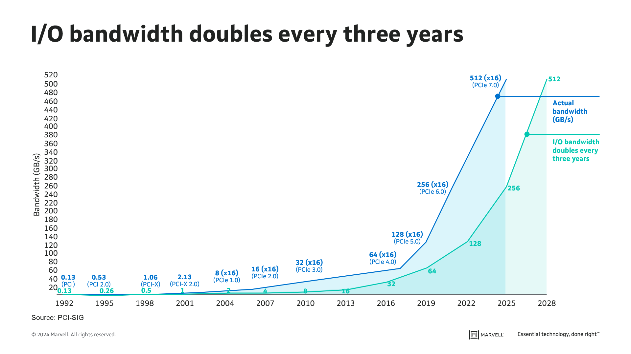
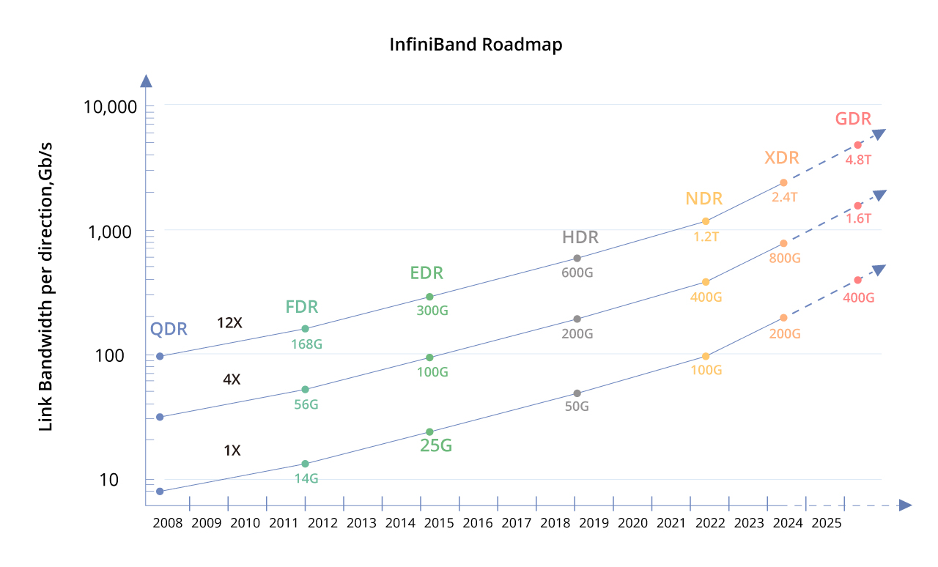
Network Capacity
PCIe
(source: https://iebmedia.com/technology/industrial-ethernet/ethernet-celebrates-50-years-with-2023-roadmap-and-demo/ )
(source: https://www.marvell.com/blogs/how-pcie-interconnect-is-critical-for-the-emerging-ai-era.html)
(source: https://community.fs.com/article/need-for-speed-%E2%80%93-infiniband-network-bandwidth-evolution.html)
Notes:
Networking bandwidth is expected to also outpace the CPU power, so more bandwidth per core.

Slide 46
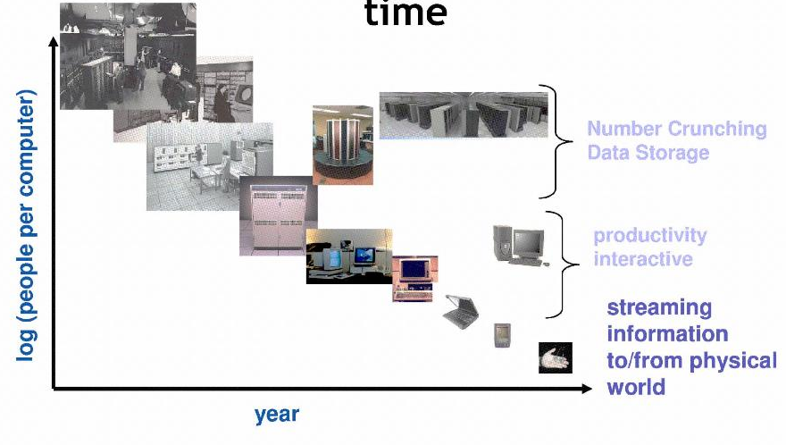
People-to-Computer Ratio Over Time
From David Culler
Today: multiple CPUs/person!
Approaching 100s?

Slide 47
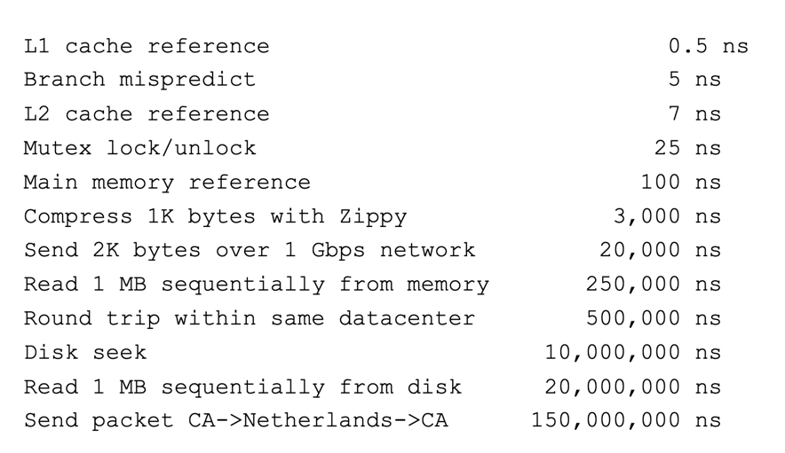
And Range of Timescales
Jeff Dean: “Numbers Everyone Should Know”

Slide 48
Challenge: Complexity
Applications consisting of…
… a variety of software modules that …
… run on a variety of devices (machines) that
… implement different hardware architectures
… run competing applications
… fail in unexpected ways
… can be under a variety of attacks
Not feasible to test software for all possible environments and combinations of components and devices
The question is not whether there are bugs but how serious are the bugs!

Slide 49
Everything going distributed and heterogeneous
Need to scale
Machine learning (AI) workloads
Big Data analytics
Scientific computing
…
Everything is connected!

Slide 50
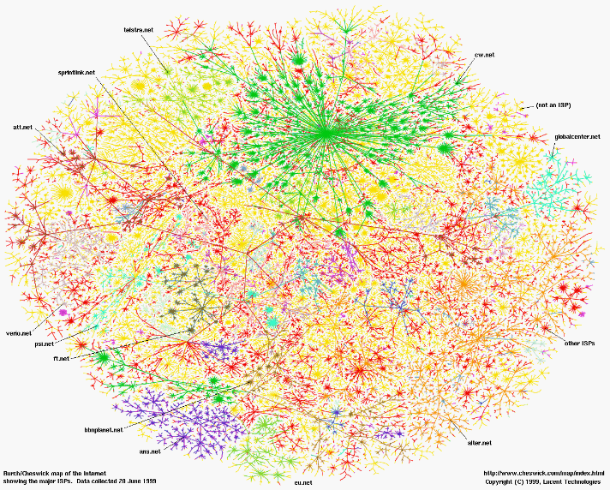
Greatest Artifact of Human Civilization…

Slide 51
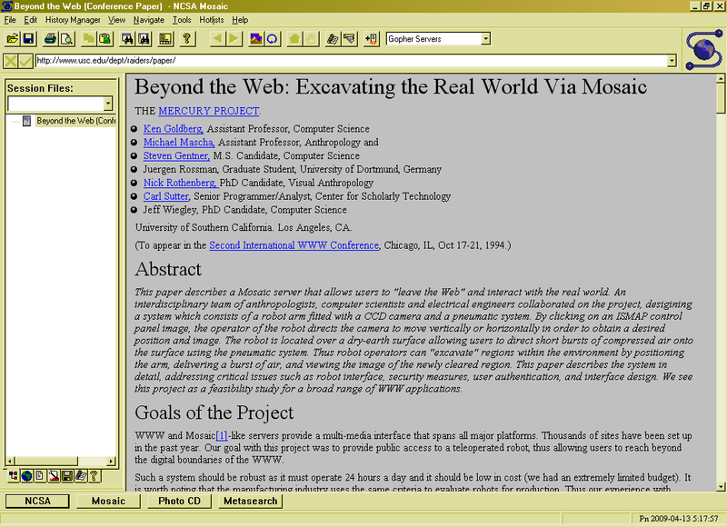
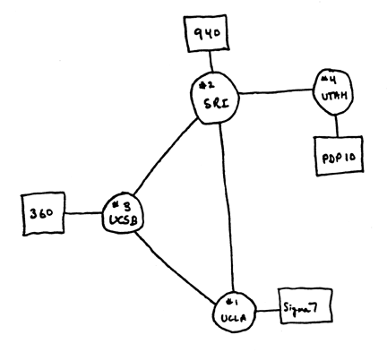
Running Systems at Internet Scale
Internet
WWW
RFC 675 TCP/IP
ARPANet
HTTP 0.9
1969
1974
1990

Slide 52
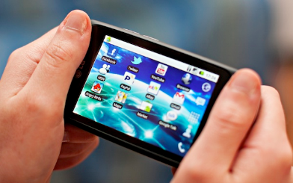
Not Only PCs connected to the Internet
Smartphone shipments exceed PC shipments in 2012!
2011 shipments:
487M smartphones
414M PC clients
210M notebooks
112M desktops
63M tablets
25M smart TVs
Now 7 billion smartphone in the world
1.17B in 2023
241.9M in 2023
128.5M in 2023
200M in 2023

Slide 53
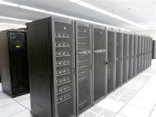
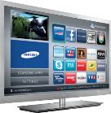
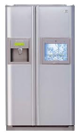
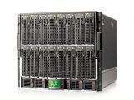








Societal Scale Information Systems (Or the “Internet of Things”?)
Massive Cluster
The world is a large distributed system
Microprocessors in everything
Vast infrastructure behind them
Gigabit Ethernet
Clusters
Massive Cluster
Clusters
Gigabit Ethernet
Internet Connectivity
Scalable, Reliable,
Secure Services
Databases
Information Collection
Remote Storage
Online Games
Commerce
…
MEMS for
Sensor Nets
Notes:
Of the enormous variety of CITRIS projects going on at Berkeley, I will present one set that is tied together by this picture: the design, construction and use of MEMS devices, the sensor networks containing them, and making the information from these networks available to widely distributed users as scalable, reliable and secure services.
The name we give to such an integrated system is a Societal Scale Information System, a name meant to evoke its scale – enormous - and purpose – benefiting people and the economy.
I will leave the details of all the specific applications that Ruzena mentioned, be it to energy efficiency or education or disaster response the social sciences, and indeed most details, to later talks and posters.

Slide 54





Example: What’s in a Search Query?
DNS
Servers
Datacenter
DNS
request
create
result
page
Search
Index
Page store
Load
balancer
Ad Server
Complex interaction of multiple components in multiple administrative domains
Systems, services, protocols, …
Notes:
In this course we are not focusing on a single node system but on the end-to-end system. The reason is very simple: today the majority of applications we use does not run on our system. Social networks, e-mail, google docs, online gamming, etc.

Slide 55

AI demands are exploding
10x every 18 months (2x every 5.7 months)
“Compute trends across three eras of machine learning”, J. Sevilla, https://ar5iv.labs.arxiv.org/html/2202.05924
Notes:
Here is a plot from last year showing that over the past 12 years the compute demands required to train state-of-the-art ML models [C] have doubled every 5.7 months. This is equivalent to the compute demands growing about 10 times every 18 months.

Slide 56
Growing gap between demand and supply
10x every 18 months
Moore’s Law (2x every 18 months)
CPU
“Compute trends across three eras of machine learning”, J. Sevilla, https://ar5iv.labs.arxiv.org/html/2202.05924
Notes:
To put things into perspective, [C] here I’m overlaying the Moore’s Law performance increase, as well as the [C] real per-core performance increase on the previous plot showing ML training compute demand.
[C] The gap between the compute demand of training the state-of-the-art models and the performance of a single core is huge, and is growing rapidly. In fact, note that even if the Moore’s law weren’t ending, it would have been of little help to bridge this gap.

Slide 57
Specialized hardware not enough
10x every 18 months
TPU*
GPU*
Moore’s Law (2x every 18 months)
CPU
“Compute trends across three eras of machine learning”, J. Sevilla, https://ar5iv.labs.arxiv.org/html/2202.05924
Notes:
Well, it turns out that while specialized hardware accelerators certainly helps, they are not enough!
Here I am overlaying the performance for both [C] Nvidia GPUs and [C] Google TPUs on the previous plot. Note that despite the fact that the Moore’s law has slowed down, these processors are still able to provide about a 2-times performance improvement every 18 months, They do so by aggressively specializing their hardware architecture for deep learning workloads.
However, despite the impressive increase in the performance of these specialized processors, they are still falling way short of satisfying the compute demands of training state-of-the-art ML models. [C] This gap still continues to grow exponentially!

Slide 58



From Servers to Pods
From servers to
Pods (hundreds of thousands of GPUs tightly connected by high-speed networks, i.e., supercomputers)

Slide 59
Increasing Software Complexity
Millions of Lines of Code
(source https://informationisbeautiful.net/visualizations/million-lines-of-code/)

Slide 60
How do we tame complexity?
Every piece of computer hardware different
Different CPU
Intel, ARM, AMD, RISC-V
Different specialized hardware
Nvidia GPUs, TPUs, Intel Gaudi, AWS Trainium/Inferentia, …
Different amounts of memory, disk, …
Different types of devices
Mice, Keyboards, Sensors, Cameras, Fingerprint readers, Face recognition
Different networking environment
Fiber, Cable, DSL, Wireless, Firewalls,…
Questions:
Does the programmer need to write a single program that performs many independent activities?
Does every program have to be altered for every piece of hardware?
Does a faulty program crash everything?
Does every program have access to all hardware?

Slide 61
Syllabus
OS Concepts: How to Navigate as a Systems Programmer!
Process, I/O, Networks and Virtual Machines
Concurrency
Threads, scheduling, locks, deadlock, scalability, fairness
Address Space
Virtual memory, address translation, protection, sharing
File Systems
I/O devices, file objects, storage, naming, caching, performance, paging, transactions, databases
Distributed Systems
Protocols, N-Tiers, RPC, NFS, DHTs, Consistency, Scalability, multicast
Reliability & Security
Fault tolerance, protection, security
Cloud Infrastructure

Slide 62



Infrastructure, Textbook & Readings
Infrastructure
Website: https://cs162.org
Textbook: Operating Systems: Principles and Practice (2nd Edition) Anderson and Dahlin
Suggested readings posted along with lectures
Try to keep up with material in book as well as lectures
Supplementary Material
Operating Systems: Three Easy Pieces, by Remzi and Andrea Arpaci-Dusseau, available for free online
Linux Kernel Development, 3rd edition, by Robert Love
Online supplements
See course website
Includes Appendices, sample problems, etc.
Networking, Databases, Software Eng, Security
Some Research Papers!

Slide 63


Learning by Doing
Individual Homeworks (2-3 weeks) - preliminary
0. Tools & Environment, Autograding, recall C, executable
1. Lists in C
2. BYOS – build your own shell
3. Sockets & Threads in HTTP server
4. Memory mapping and management
5. Map Reduce
Three (and ½) Group Projects
0. Getting Started (Individual, before you have a group)
1. User-programs (exec & syscall)
2. Threads & Scheduling
3. File Systems

Slide 64

Group Projects
Project teams have 4 members!
never 5, 3 requires serious justification
Must work in groups in “the real world”
Same section (at least same TA)
Communication and cooperation will be essential
Regular in-person meetings very important!
Joint work on Design Documents
Slack/Messenger/whatever doesn’t replace face-to-face!
Everyone should do work and have clear responsibilities
You will evaluate your teammates at the end of each project
Dividing up by Task is the worst approach. Work as a team.
Communicate with supervisor (TAs)
What is the team’s plan?
What is each member’s responsibility?
Short progress reports are required
Design Documents: High-level description for a manager!

Slide 65
Getting started
EVERYONE (even if you are on the waitlist!): Start homework 0 right away (hopefully Today!), project 0 next week
Github account
VM environment for the course
Consistent, managed environment on your machine
Get familiar with all the cs162 tools
Submit to autograder via git
First two weeks, attend any section you want
We’ll assign permanent sections after forming project groups
Section attendance will be mandatory after we form groups
These section times will be adjusted after we have a better idea where people are

Slide 66
Preparing Yourself for this Class
The projects will require you to be very comfortable with programming and debugging C
Pointers (including function pointers, void*)
Memory Management (malloc, free, stack vs heap)
Debugging with GDB
You will be working on a larger, more sophisticated code base than anything you've likely seen in 61C!
Review Session on the C language
Time and logistics TBA, but soon!
"Resources" page on course website
Ebooks on “git” and “C”
C programming reference
https://cs162.org/ladder/
First two sections are also dedicated to programming and debugging review:
Attend ANY sections in first two weeks

Slide 67
Grading (Tentative breakdown)
36% three midterms (12% each)
Thursday, 10/3 (7-9pm or 8-10pm), No class on day of Midterm
Tuesday, 11/05 (7-9pm or 8-10pm), No class on day of Midterm
Thursday, 12/05 (7-9pm or 8-10pm), No class on day of Midterm
These will be IN-PERSON!
36% projects
18% homework
10% participation (Sections, Lecture, …)
No final exam
Projects
Initial design document, Design review, Code, Final design
Submission via git push triggers autograder

Slide 68


CS 162 Collaboration Policy
Explaining a concept to someone in another group
Discussing algorithms/testing strategies with other groups
Discussing debugging approaches with other groups
Searching online for generic algorithms (e.g., hash table)
Sharing code or test cases with another group
Copying OR reading another group’s code or test cases
Copying OR reading online code or test cases from prior years
Helping someone in another group to debug their code
We compare all project submissions against prior year submissions and online solutions and will take actions (described on the course overview page) against offenders
Don’t put a friend in a bad position by asking for help that they shouldn’t give!

Slide 69
Lecture Goal
Interactive!!!
Ask Questions in Chat

